Slide 1
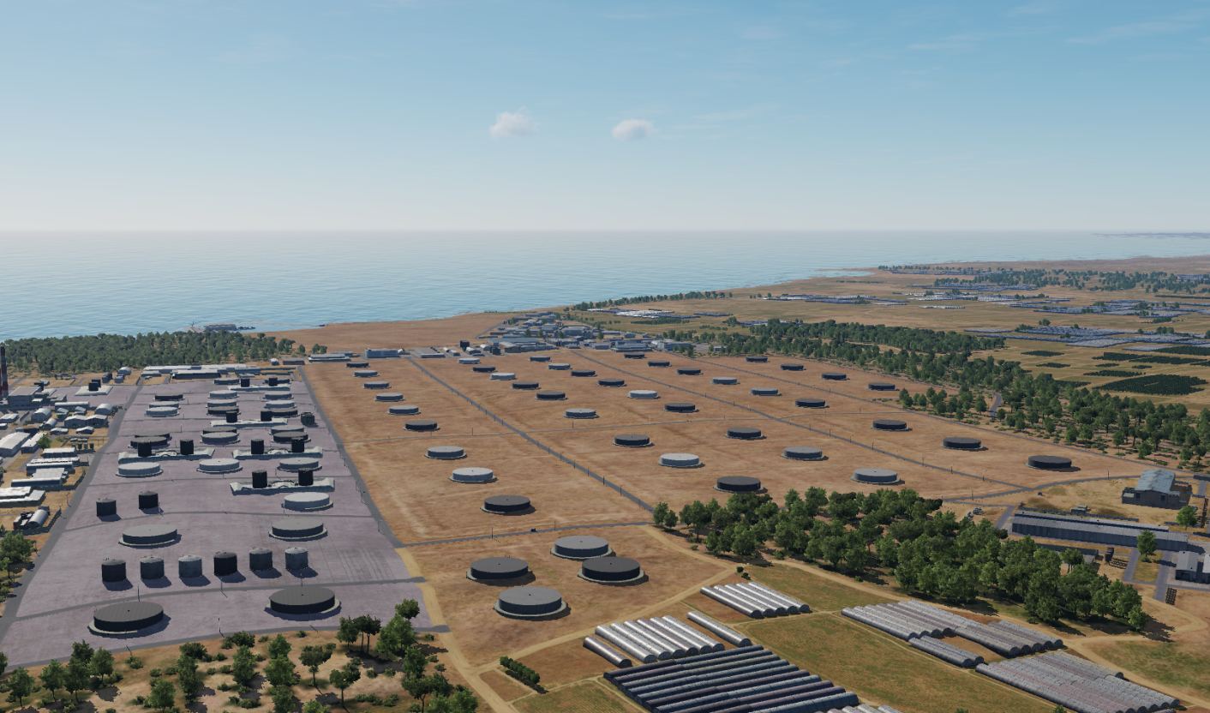

SYTGT089 Oil Storage
N
89
DESCRIPTION OF THE DESIRED POINTS OF IMPACT:
SYTGT089 – Oil Storage Facility
Double skinned oil tanks made of metal situated on concrete base.
4
Weapon Type: Suggested solution on DPIs 1-25: CBU-87 with bomblet footprint coverage of 400 x 200m.
5
6
7
8

Slide 2
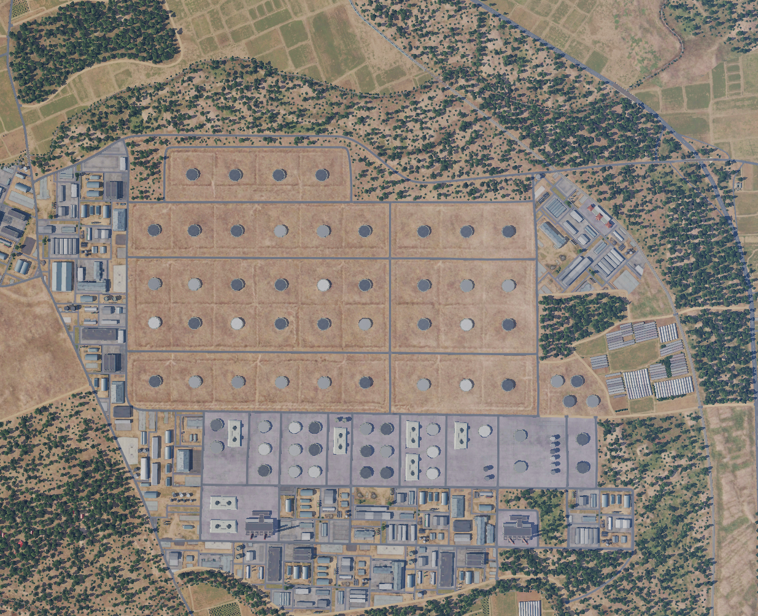
SYTGT089 Oil Storage
DESIRED POINTS OF IMPACT:
DPI 1: N 35 13.569 E 035 57.891/59ft
DPI 2: N 35 13.508 E 035 58.083/72ft
DPI 3: N 35 13.477 E 035 57.802/49ft
DPI 4: N 34 13.421 E 035 57.992/69ft
DPI 5: N 35 13.362 E 035 58.179/85ft
DPI 6: N 35 13.298 E 035 58.399/105ft
DPI 7: N 35 13.378 E 035 57.759/52ft
DPI 8: N 35 13.323 E 035 57.951/79ft
DPI 9: N 35 13.264 E 035 58.135/92ft
DPI 10: N 35 13.198 E 035 58.354/102ft
DPI 11: N 35 13.307 E 035 57.729/52ft
DPI 12: N 35 13.251 E 035 57.920/82ft
DPI 13: N 35 13.195 E 035 58.106/85ft
DPI 14: N 35 13.128 E 035 58.329/102
DPI 15: N 35 13.203 E 035 57.685/49ft
DPI 16: N 35 13.145 E 035 57.876/49ft
DPI 17: N 35 13.089 E 035 58.058/62ft
DPI 18: N 35 13.021 E 035 58.275/89ft
DPI 19: N 35 13.049 E 035 57.747/59ft
DPI 20: N 35 13.003 E035 57.895/69ft
DPI 21: N 35 12.952 E 035 58.052/89ft
DPI 22: N 35 12.922 E 035 58.151/89ft
DPI 23: N 35 12.866 E 035 58.341/118ft
DPI 24: N 35 12.829 E 035 58.459/131ft
DPI 25: N 35 12.939 E 035 58.509/128ft
N
89
1
2
3
4
5
6
7
8
9
10
11
12
13
14
15
16
17
18
25
19
20
21
22
23
24

